Slide 1
C2M2 Program
Blogs and Communication

Slide 2
Agenda
Overview (Erika)
MapGive and C2M2 Communications Plan
Requirement (in statement of work)
Guidance and advice (opportunities)
Questions & Further Discussion

Slide 3
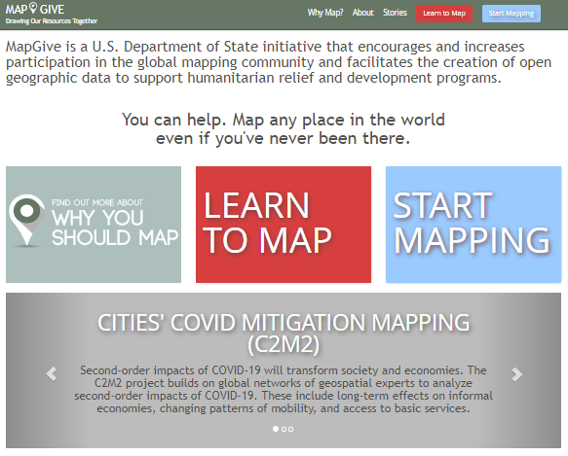



MapGive - Cities’ COVID Mitigation Mapping
“MapGive is a U.S. Department of State initiative that encourages and increases participation in the global mapping community and facilitates the creation of open geographic data to support humanitarian relief and development programs.”
Notes:
Public diplomacy initiative that encourages open mapping connections with the state department and gis data driven solutions to humanitarian and development issues.
Encouraged the development and attention on the open mapping community
White house mapathons
State department HQ mapping events
Supported field based open data collection
Integrating open mapping workshops into existing state department programming
upload to & link to the MapGive youtube channel for videos we want to share publicly, especially for events and webinars that State hosts and that aren't primarily being hosted by one of the hubs or partners.
MapGive youtube channel vs hub/partners' webpages --
For the partners' videos, we could offer the option of hosting event recordings or videos on the MapGive youtube channel, but would want to be in communication with them about doing so, to make sure we can review and describe the event accurately. If the hubs or partners' already have or are growing their own followings on their own platforms, they could continue using their own page, and we could link to or embed on the MapGive website from there.
Uploading to the google drive --
Right now, the google drive is split into regional hub folders and various admin folders for the C2M2 State/AAG management team - we can create a new folder in the google drive for "C2M2 Videos" for videos that we plan to upload to that youtube channel (eg webinars or events that aren't primarily hosted by one of the hubs or partners) and ask the hubs to upload any raw videos to a subfolder (so that Mel you have one less thing to manage).
Uploading to the mapgive youtube --
Tom and I have the password to the youtube account and can plan to upload the videos as needed. We can plan to use use the launch video to set the example for formatting (title should mention Cities' COVID Mitigation Mapping and description should include a description and link to the C2M2 webpage).

Slide 4
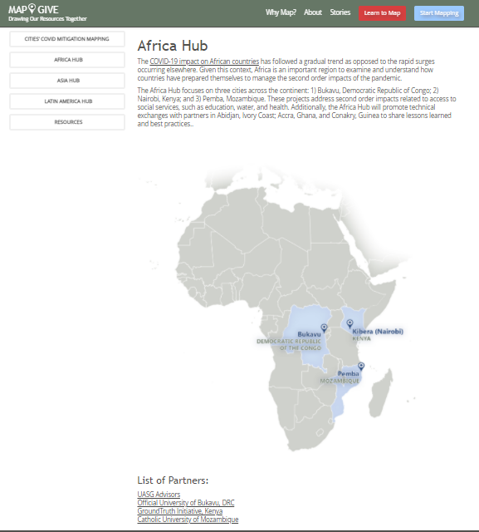
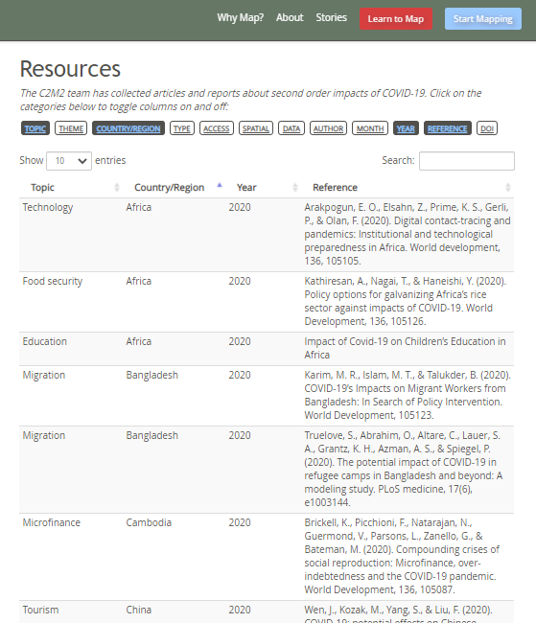
Notes:
An important part of that communications strategy is making a centralized, engaging web presence available so that the work of the hubs and projects across all of the cities and regions is discoverable in one place
Africa hub page: https://mapgive.state.gov/c2m2/#africa-hub
Whimsical draft: https://whimsical.com/mockup-c2m2-Wbq5xS1nCpGL9xcxizcMnD

Slide 5
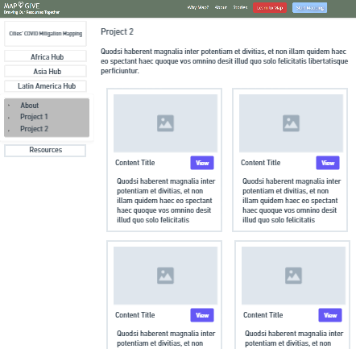
Notes:
An important part of that communications strategy is making a centralized, engaging web presence available so that the work of the hubs and projects across all of the cities and regions is discoverable in one place
Africa hub page: https://mapgive.state.gov/c2m2/#africa-hub
Whimsical draft: https://whimsical.com/mockup-c2m2-Wbq5xS1nCpGL9xcxizcMnD

Slide 6

C2M2 Communication Plan - share, connect, educate
Select blog topics (title and/or description)
Press/articles
Academic papers
Audience (primary, secondary)
Separate post
Videos
Choose platform for dissemination
Context statement
Blogs
Co-authored MapGive story
Review
Social media
Post blog!
Webinars
Workshops
Publicize
Notes:
Questions for any comms:
Topic: title and/or description
Audience: primary, secondary, etc
Dissemination method(s): What platform/media?
Creator(s): Which organization will author? POC?
Timing: When will it occur and/or when should this be published/released?
Prioritization: How does this support the C2M2 strategy? Is this a contractual obligation? Who within the C2M2 program will this benefit and how?
Planned comms (by creator):
C2M2 Hubs and Projects:
Blogs
Min 1 x quarter/hub, more welcomed
Posted or linked to MapGive.state.gov/C2M2 page
Retweets, hashtags, and other planned ways to publicize?
Key audiences:
Primary: C2M2 project teams and their local partners
Secondary: potential local/regional/international partners and/or practitioners
Tertiary: USG, intl practitioners, public
HIU and MapGive:
Reference documentation
Blog best practices
Public Diplomacy for Posts guidance document
Social Media Toolkit
Website sections:
early Dec 2020 - Introductory pages for program, hubs. Resources tab with lit review.
Week of Feb 1: 1st blog post, Mel’s introduction
Twitter
Key Audiences:
1 - C2M2 projects and their partners,
2 - USG
3 - other practitioners in this space (geographers, etc)
4 - public awareness
AAG:
Blogs and other content
AAG website
AAG practitioner panel presentations
others?
NSF/STC:
3 Webinars:
1) Dec 2020, “Project introductions.” Audience: C2M2 project teams and working partners, ie NSF interns). Recording to be available on MapGive Youtube site. Creators: Mel and C2M2 hub teams.
2) Feb 2021 “Ethics of Participatory Mapping during COVID.” Audience: C2M2 project teams and working partners, ESTH officers? Dissemination: webinar, recording?
3) April? July/August?
3 white papers:
Symposium (multiple days?)
Topics: overarching themes of tourism, economics,
Speakers: panels on each topic? - include practitioners/researchers, C2M2 project leads?
Timing: late May/early June
Key audiences:
Primary: C2M2 project and hub teams and their working-level partners, supporting partners (ie CGA interns)
Secondary: expand network of potential local/regional/int’l practitioner partners
Tertiary: USG
Additional publication opportunities:
Dec 2020, submitted: Annals of GIS article for COVID special issue
2021: Springer Book proposal
Lead: Melinda
Chapters from project partners and/or hubs
Strategy - help teams to prioritize this among other publication/comms opportunities.
Press – invite press to event with Ambassador, Mayor, and head of the local academic/NGO partner to announce program and, later, the launch of project activities; arrange interviews on local TV programs for the Ambassador, focused on how project will help local leaders and communities create more sustainable cities that are more resilient to disaster.
Public Engagement Events – Invite friends of the Embassy (exchange program alumni, regular attendees of related State Dept programs) and encourage your local partner to invite students and affiliates to the project launch and do hands-on mapping exercise around a prominent public space (invite press); ask all USG and affiliates to do speaker programs when doing site visits for the C2M2 project;

Slide 7
C2M2 Blogs - requirements, flexibility
Requirement
“Authoring and publication of blog post by the 30ths of the third month in the quarter, published in coordination with DoS and AAG”
Each hub produces 1 blog per quarter with support from project teams
Highly recommended to notify team before publishing
The C2M2 management team review will be focused on ensuring consistency between C2M2 content, and is available to review content’s writing style and to help develop blog ideas.
Important Dates
Q1: Oct 15 - Jan 15
(flexible to late Jan/early Feb)
Q2: Jan 16 - April 15
Q3: April 16 - July 15
Q4: July 15 - Oct 15
Notes:
Frequency/Timing
Minimum 1 blog per quarter per hub required - more is always welcome, and we can happily support.
Please let us know if you would like it to be posted during a specific week or ahead of an important date.
Note about important dates:
Blogs can be published at any time during each quarter.
We don’t need to clear for their blogs that aren’t on the mapgive website, but we are available for assistance.
Lots of flexibility

Slide 8
C2M2 Blogs - requirements, flexibility
Where to host
Project/hub or other web presence
*Option to co-author a “Mapgive story”
Clearance
Only MapGive stories require additional State approval
*Proactively reference and link activities and topics to C2M2 where possible
““For more information about the Cities’ COVID Mitigation Mapping (C2M2) program, please go to mapgive.state.gov/c2m2.”
Language
There isn’t a strict English-only requirement, we recommend considering it depending on your audience.
*MapGive stories would need, at least, a version translated in English (story can include multiple language versions)
Digital Branding – So that each C2M2 project can contribute to the communications success of the others, all social media and blog posts for C2M2 should aim to have consistent branding. When possible, refer to the “C2M2 Communications Toolkit” (under development) at
C2M2 Blog Reference Checklist
C2M2 Communications Toolkit
C2M2 Social Media Cheat Sheet
Notes:
“Cities' COVID Mitigation Mapping (C2M2) aims to 'map' such second order impacts on different sectors across 12 cities on 3 continents. Three cities in Asia, three cities in Africa and six cities in Latin America are working to catalog the existing data on, and mitigating efforts of, such impacts on various aspects of their cities and their citizens.”
“The Cities’ COVID Mitigation Mapping (C2M2) program is part of the U.S. commitment to enable countries to develop its own capacities to mitigate COVID-19 second order impacts and help build resilient communities.”
“C2M2 project partners use participatory tools to create maps that support mitigation strategies to reduce the local second order effects of COVID-19, such as improved sustainability, such as work to improve water management, reduce waste, and manage sprawl (unplanned growth and development).”

Slide 9
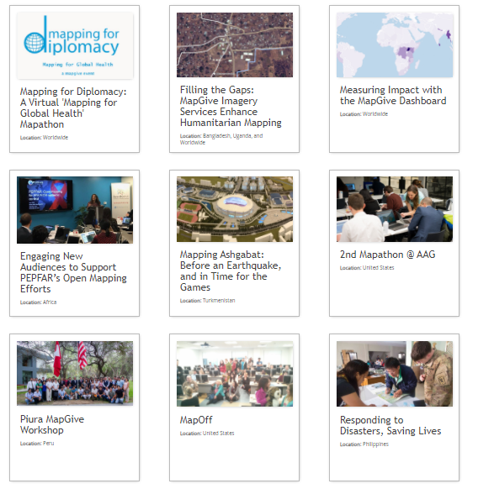
C2M2 - utilizing MapGive’s platform
Proposed pre-approved subject matter as part of blanket authorization for HIU social media accounts will include the following (all content will conform to content rules outline in 3 FAM 4175.2):
Appropriate content from core colleagues, i.e. OFDA, YouthMappers, 2C, Humanitarian OpenStreetMap Team, American Red Cross, Missing Maps, World Bank GFDRR.
News and blog posts relevant to the humanitarian mapping community
News of significant events and annual milestones, i.e OpenStreetMap conferences and other key messages on important dates such as World AIDS Day
Announcements and RSVP links for mapathons/events occurring throughout the humanitarian mapping community
Information in support of and encouraging mapping in Universities and Schools
Encouraging information in support of mapping in response to natural disasters
Photos of mapping related activities
Text-based messages designed to grow and motivate an audience of volunteer mappers
Encouraging general mapping and validation, encouraging mapping towards targeted mapping campaigns
Metrics related to MapGive projects and user contributions, Imagery to the Crowd success stories, messages acknowledging volunteers supporting MapGive
Tips or Information on instructional mapping related guides
HIU infographics designed to grow and motivate an audience of volunteer mappers
Congratulations to core colleagues and partners on key accomplishments
Notes:
Pros-cons
Pros - more direct assistance, co-authorship, very overt support from DoS (though they have the support regardless for c2m2), direct lines, insight
*hiu mapgive team could liaise with state pocs and gpa to maximize
Cons - more involved, clearances, could water down some of the more specific points because it’s going to be in the tune of “us foreign policy”

Slide 10
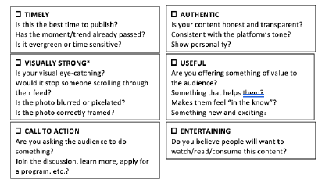
C2M2 Blogs - Best Practices
Notes:
If you selected all 6, that’s ideal content
If you selected ⅚, your content is good
If you selected 4/6, you content is acceptable, but it might need some work
If you selected 3/6, the content might not be ready for publishing. Regroup to improve or coordinate with hub or c2m2 team.
Blog writing q&a tips (timing, syntax)
Event timing
Milestone timing
Word count
Engaging! Photos, videos, clips
Reinforcing links to other
Share plans for content with C2M2 team
Approach for partners suggestions to hubs
Rolling approach
Monthly approach
Event recaps, Event promotion
Quarterly review
Project focus
Common themes focus
Hub leads could work together
How to Publicize
MapGive
State Department (embassies, pd staff, gpa)
AAG?
C2M2 network

Slide 11


Open for discussion
Any questions?

